Slide 1
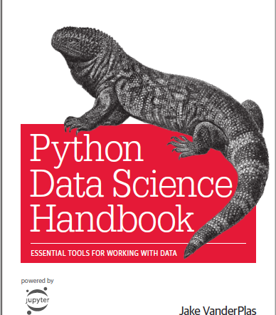
Python for Data Science
https://github.com/jakevdp/PythonDataScienceHandbook

Slide 2
Data Science with Python
Get Data
Data Pre-proc essing
Analysis And Modeling
Evaluate And Present
Beautiful Soup
LXML
Tweepy
Pandas
Pandas
NLTK
Scikit
Matplotlib
Numpy
Scipy
Sympy
Sklearn
Statsmodels
IPython
Bokeh
Flask

Slide 3
IPython
Interactive Python started in 2001 as an enhanced Python interpreter
Developed by Fernando Perez as “Tools for the entire life cycle of research computing”
If Python is Engine, IPython as the interactive control panel.
Closely tied with the Jupyter project which provides browser based notebook
Two modes
IPython shell (Anaconda prompt -> Ipython)
Jupyter notebook (Anaconda prompt -> jupyter ntoebook)

Slide 4
IPython features
Refer to online notebooks:
https://github.com/jakevdp/PythonDataScienceHandbook/blob/master/notebooks/01.00-IPython-Beyond-Normal-Python.ipynb

Slide 5
Data as numbers
Datasets can come from a wide range of sources and formats
E.g. documents, images, sound clips, numerical measurements
Data is fundamentally array of numbers
Digital images are 2D arrays of numbers representing pixel brightness across the area
Sound clips are 1D arrays of intensity versus time
Text can be converted in various ways into numerical representations
First step in making data analyzable is to transform it into arrays of numbers
Both, NumPy and Pandas package efficiently store and manipulate numerical arrays

Slide 6
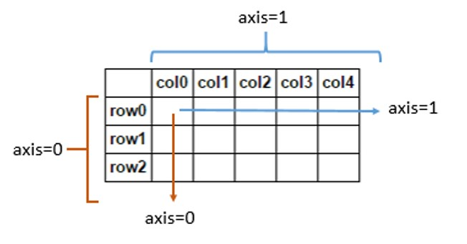
NumPy
Stands for Numerical Python
Efficient interface to store and operate on dense data buffers
NumPy arrays are similar to Python’s built-in list type, but provide much more efficient storage and data operations for larger arrays
Form the core of data science tools in Python

Slide 7
NumPy features
Refer to online notebooks:
https://github.com/jakevdp/PythonDataScienceHandbook/blob/8a34a4f653bdbdc01415a94dc20d4e9b97438965/notebooks/02.00-Introduction-to-NumPy.ipynb

Slide 8
Pandas
Built on top of NumPy and provides efficient implementation of a DataFrame
DataFrame is multi-dimensional array with attached row and column labels
DataFrame may contain data with heterogeneous types and/or missing data
Provides a number of powerful data operations using Series and DataFrame objects

Slide 9
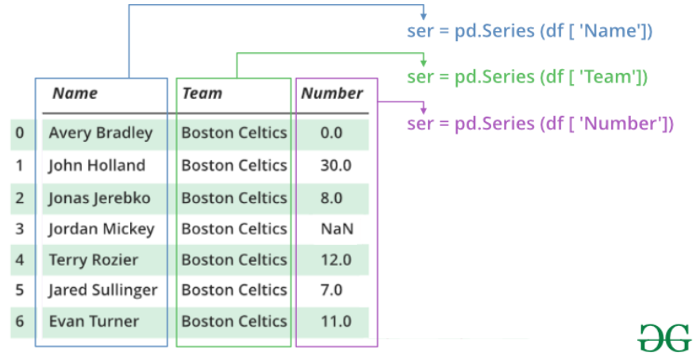
Pandas Series and DataFrame

Slide 10
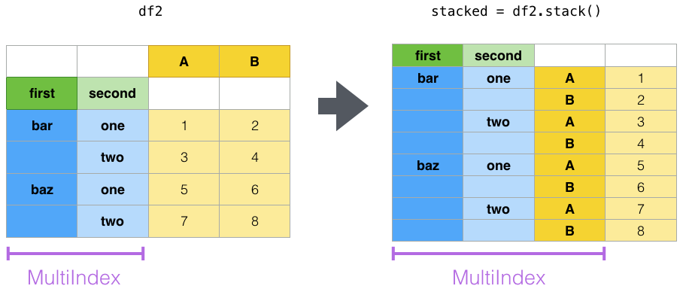
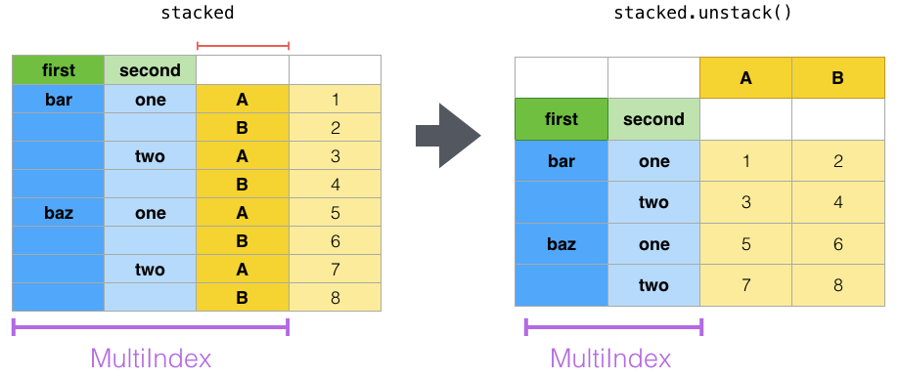
Pandas Stack vs Unstack
Convert a DataFrame into multiple indexed series
Convert a multiple indexed series into a DataFrame

Slide 11
Pandas features
Refer to online notebooks:
https://jakevdp.github.io/PythonDataScienceHandbook/03.00-introduction-to-pandas.html

Slide 12
Practice exercises for Midterm 2
NumPy exercises: https://www.w3resource.com/python-exercises/numpy/index.php
Pandas exercises: https://www.w3resource.com/python-exercises/pandas/index.php
I will try to come up with some exercises (but keep practicing above).

Slide 13
SciKit Learn
Provides efficient implementation of a large number of machine learning algorithms
Clean, uniform, streamlined API along with online documentation
Understand Scikit-Learn for one type of model and switch to other model effortlessly

Slide 14
SciKit Learn – Steps in using the API
Choose a class of model by importing the appropriate estimator class from Scikit-Learn.
Choose model hyperparameters by instantiating this class with desired values.
Arrange data into a features matrix and target vector following the discussion above.
Fit the model to your data by calling the fit() method of the model instance.
Apply the Model to new data:
For supervised learning, often we predict labels for unknown data using the predict() method.
For unsupervised learning, we often transform or infer properties of the data using the transform() or predict() method.

